Slide 1

Leo Linux Potential Design Ideas
Chase Franse & Nicholas Cupo

Slide 2
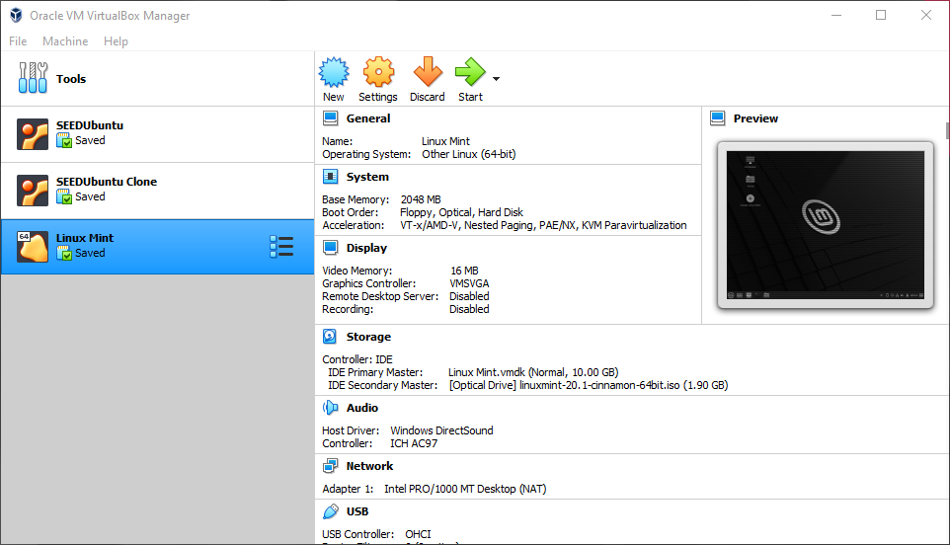
Group 2 Project “Prototype”: Leo Linux
Unfortunately, due to the complexity of the project, we do not yet have a working prototype to show. Instead, our group elected to use a currently built and stable version of Linux to brainstorm potential design ideas for what our GUI might look like. Of course, the desktop background and some of the icons will be different in our completed project, we just haven't gotten quite that far yet.
For this set of potential designs, we used Linux Mint as our stable build in which we manipulated the position of the taskbar itself, as well as what common tools/features we wanted to include on it.

Slide 3
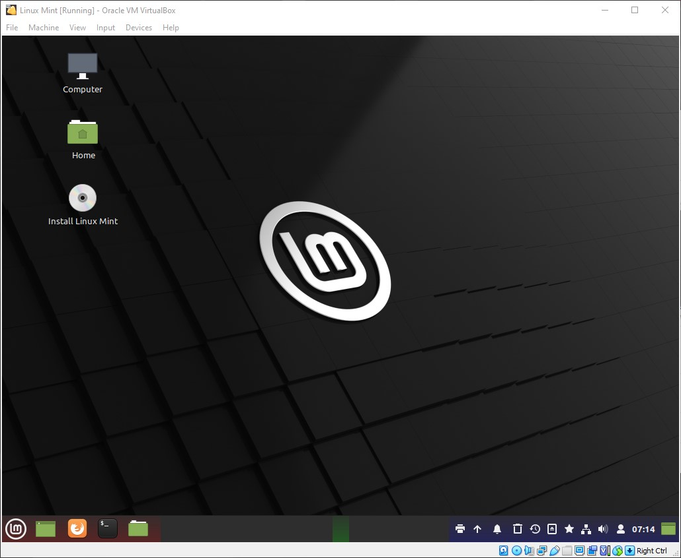
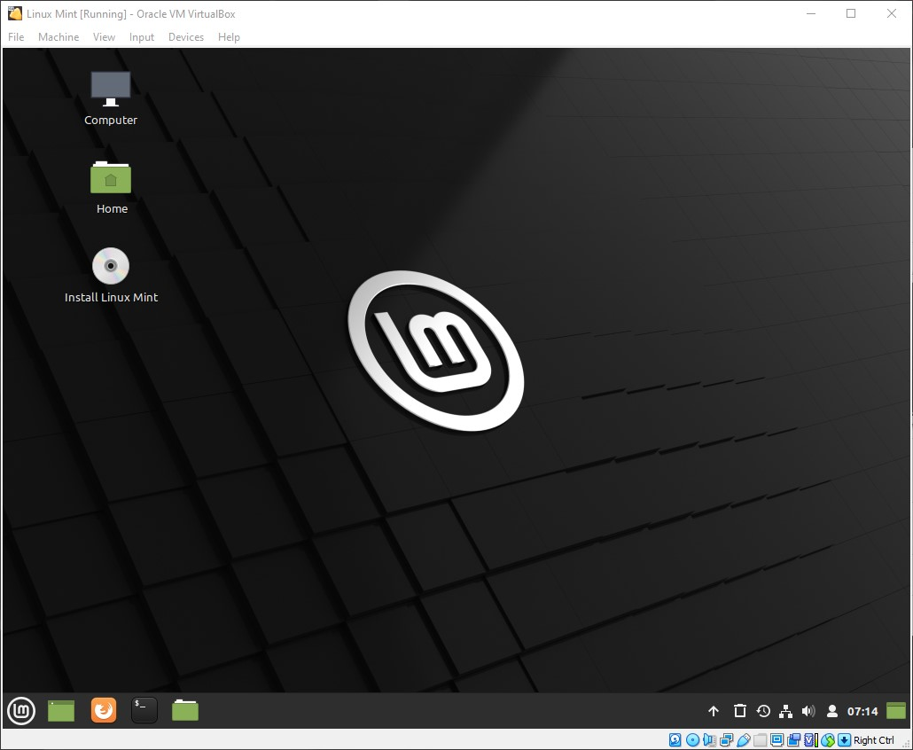
Potential #1: Windows Doppelganger
Edit Mode
User Mode
This potential design is very similar to the classic Windows design. The traditional “Start” menu is there, followed by pinned and open programs, followed by the system tray, clock, and “Desktop Preview.”
The only difference between Windows and this GUI design is a more comprehensive list of tools/features included in the System Tray upon boot.

Slide 4
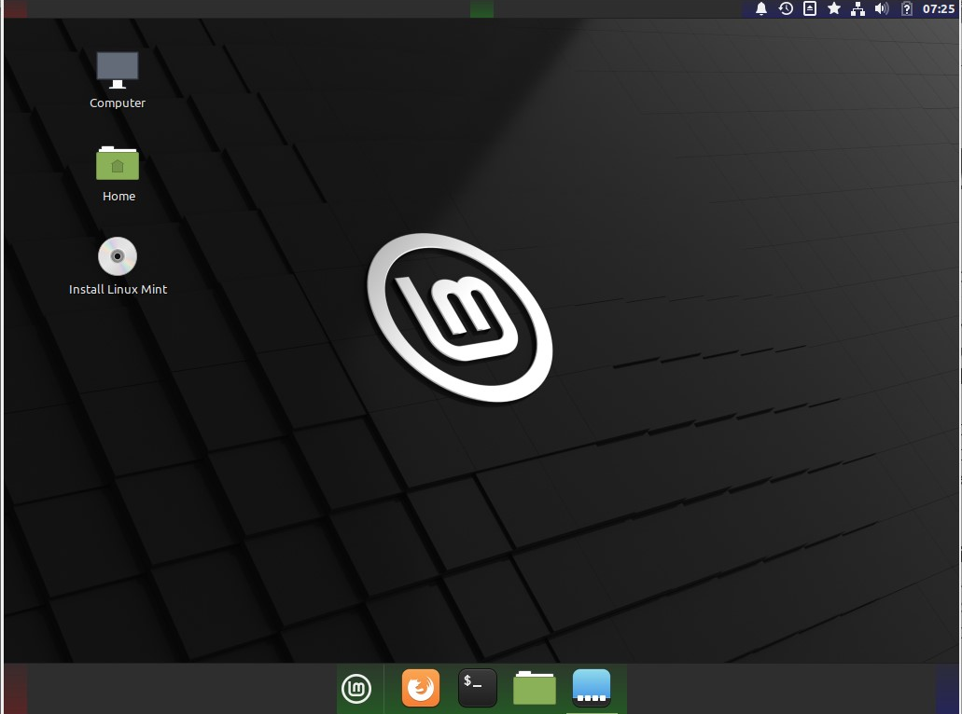
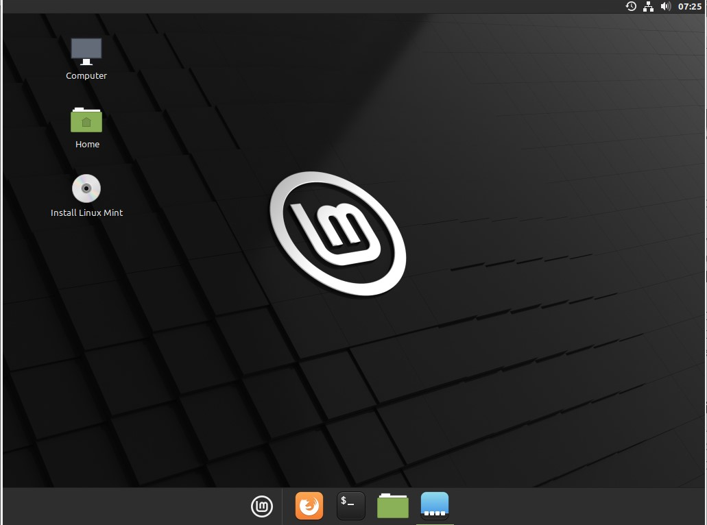
Potential #2: macOS Doppelganger
Edit Mode
User Mode
This potential design is very similar to the macOS model. There is a top panel with a limited system tray and clock, as well as a bottom panel with the “Start” menu as well as the pinned and open programs.
This design also includes the “Intelligent Hide” feature on the bottom panel – this hides the full bottom panel similarly to how it is done in macOS.

Slide 5
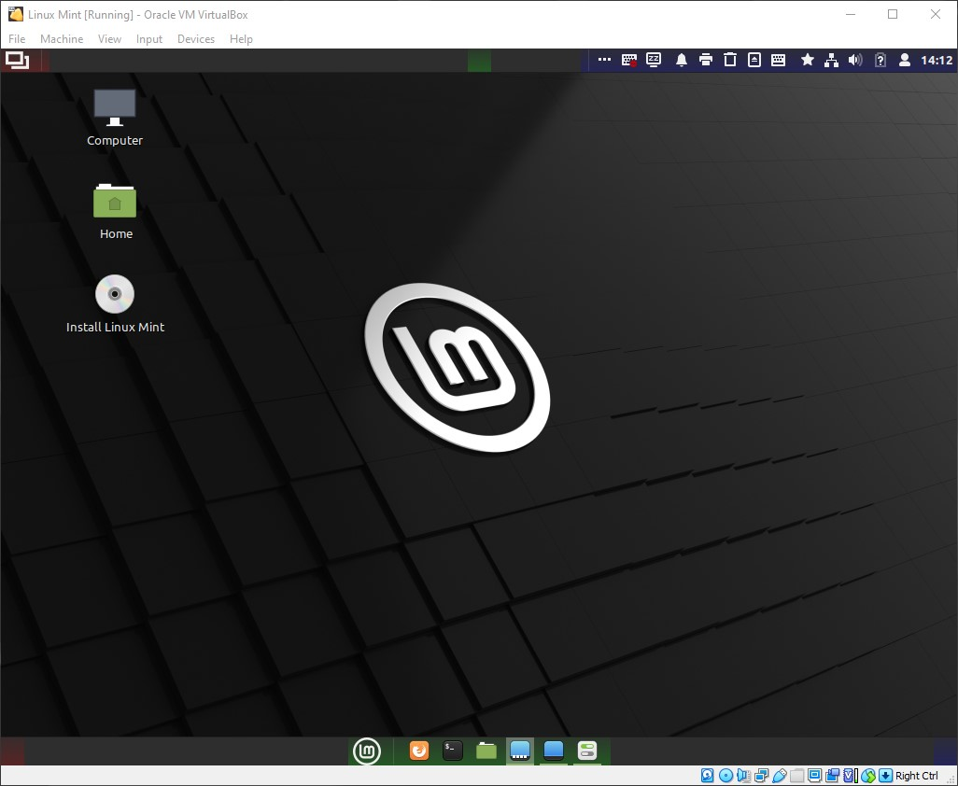
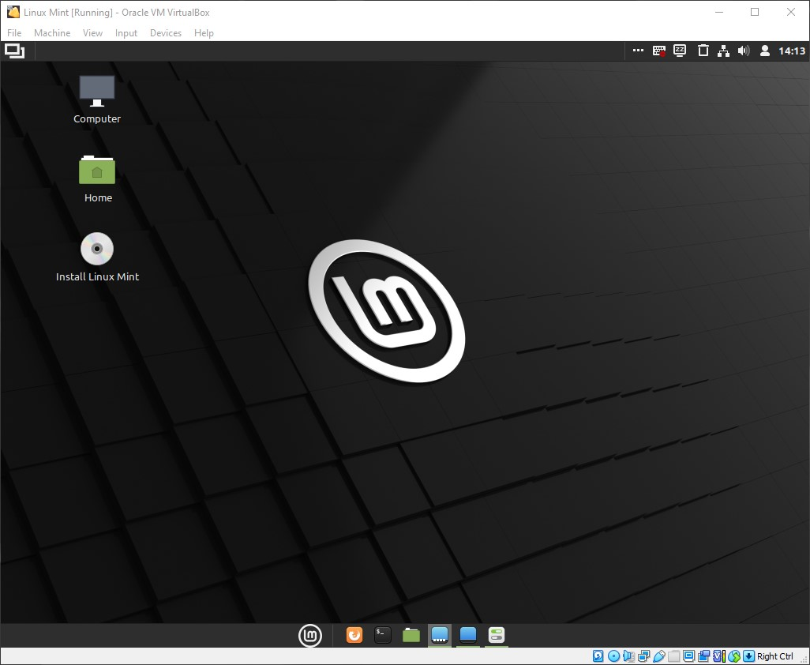
Potential #3: Custom Two-Bar
Edit Mode
This design is a custom one that our team created as a possibility. This design features a top panel with a comprehensive system tray and clock on the right side, as well as a “Window Quick List” – this is a list of all open programs, displayed in a simple click-able list so that active programs can be found easier.
This design also features are bottom panel very similar to macOS but does not include the “Intelligent Hide” feature.
User Mode

Slide 6
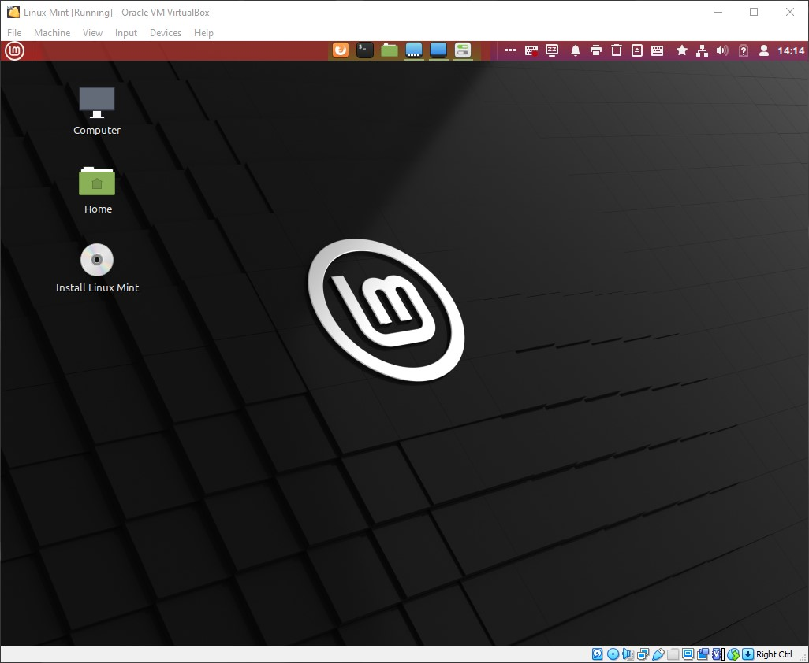
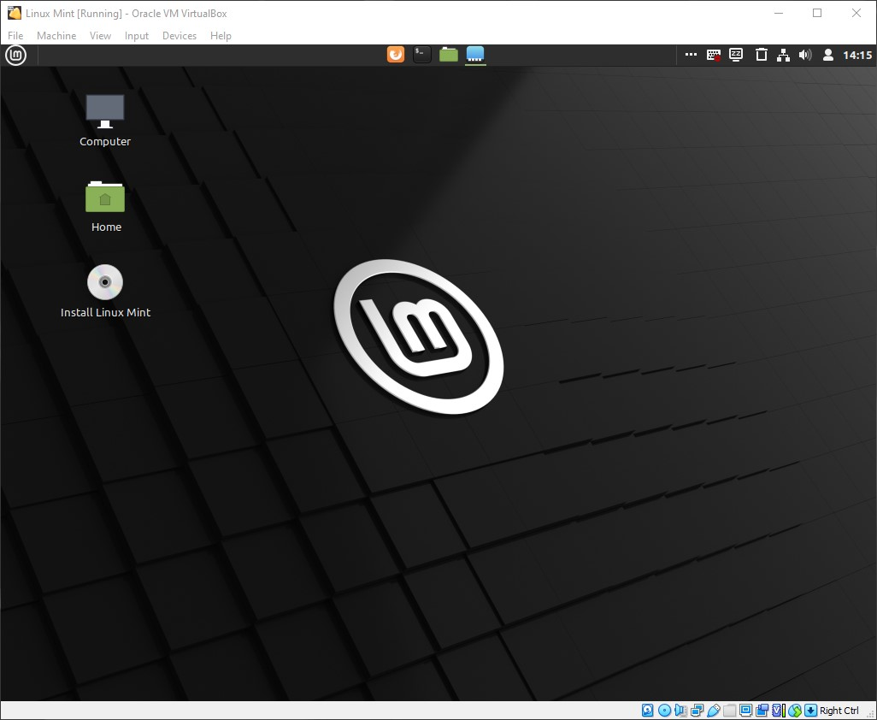
Potential #4: Custom Top-Bar
Edit Mode
User Mode
This design features no bottom panel at all, and instead includes all of the features previously seen in a single top panel.
On the right, this panel has a System Tray that includes as many potentially useful tools/features that we could find in the Linux Mint add-on list. In the center of this panel is a list of pinned and currently running programs. And finally, on the left is the usual application menu window.

